Slide 1


Day 29
contact@anubhavtrainings.com
ABAP RESTFUL APPLICATION PROGRAMMING

Slide 2

Agenda – Day 29
Create CDS View for Approver
Implementation of Behaviour Definition
Create Service Definition to Expose Entity
Create Service Binding

Slide 3
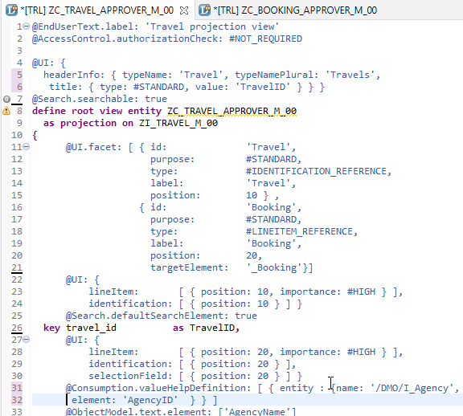
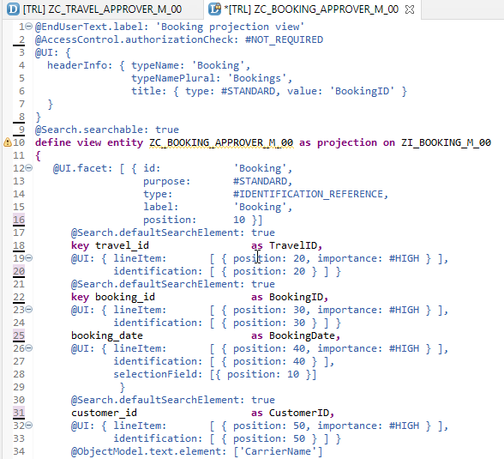
Create CDS View’s for Approver
Projection CDS View for Travel Info “ZC_TRAVEL_APPROVER_M_00”
Projection CDS View for Booking Info “ZC_BOOKING_APPROVER_M_00”

Slide 4
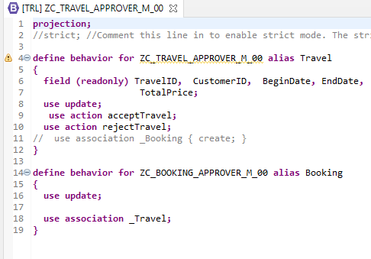
Implementing Behaviour Definition
“ZC_TRAVEL_APPROVER_M_00”
Behavior Definition for Projection CDS’s Views of Processor.

Slide 5
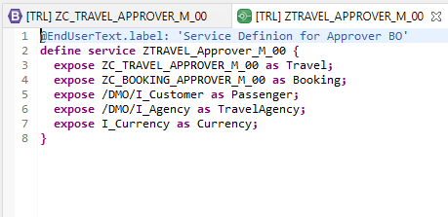
Service Definition
“ZTRAVEL_APPROVER_M_00”
Service Definition for Expose Entity

Slide 6
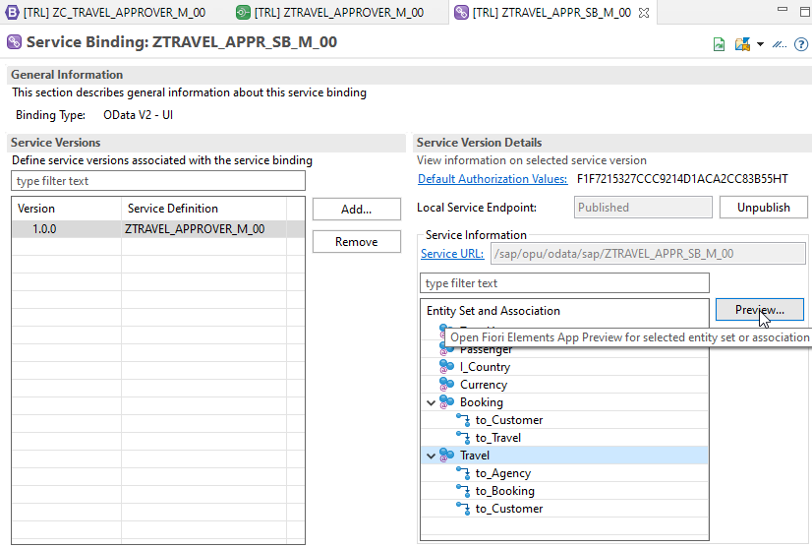
Service Binding
After Creating Service Binding , Select Entity and Click on Preview

Slide 7
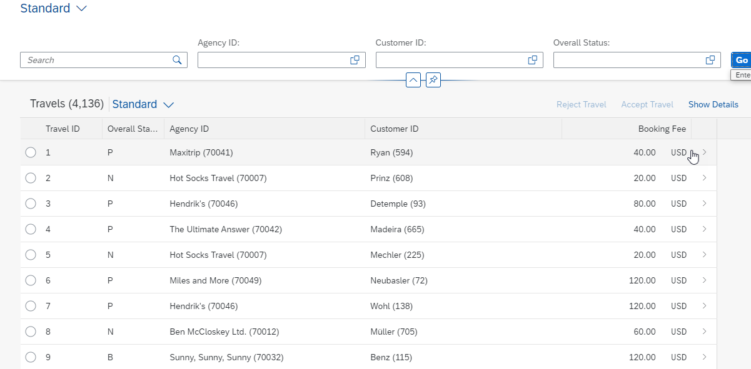
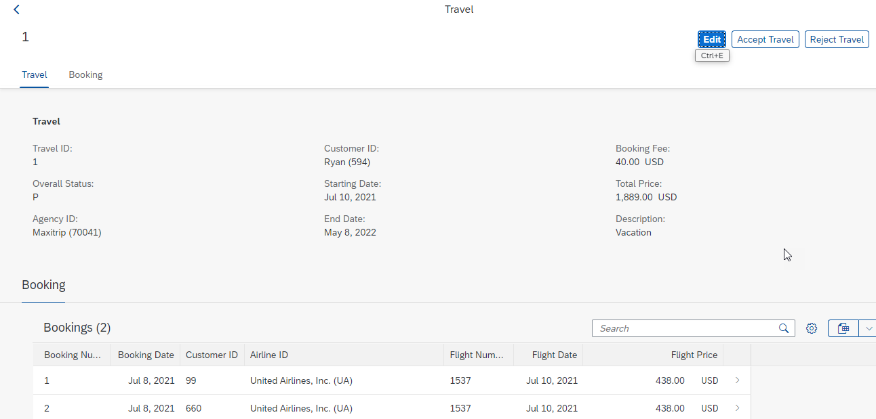
Final Result for Approver App
1st Screen with Search Bar & Filter Bar
2nd Screen with Travel and Booking Data,
& Approve or Reject Functionality

Slide 8

End of Day 29
Trainer: Anubhav Oberoy

Slide 9

Trainer: Anubhav Oberoy

Slide 10
THANK YOU
If you cannot do
great things, do small things in a great way.
Anubhav Oberoy
https://www.anubhavtrainings.com

Slide 11


We’re committed to empower you to be
Most Desirable Resource
through powerful training solutions.
We build the workforce of the future.
250+
Corporate Clients
30,000+
Learners Trained
25000+
Learners Placed
FREE WEBINARS
Sign up for free webinars with industry experts every fortnight!
Enroll Now!
Contact us today!
https://anubhavtrainings.com/

Slide 12




More from AnubhavTrainings.com

